Slide 1
Excel Internal Assessment
Sajja Tarun Teja - 4391

Slide 2
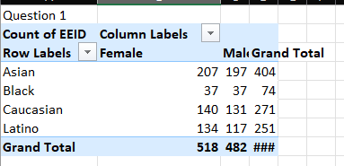
Question 1:
Gender And Ethnicity Distribution. Asian and the most common and Black are the least.

Slide 3
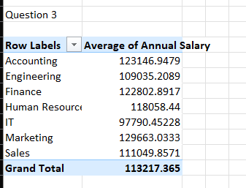
Question 3:
Average Salaries based on departments

Slide 4
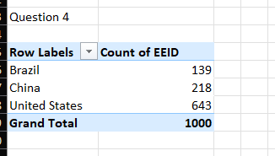
Question 4:
US has the highest number of employees

Slide 5
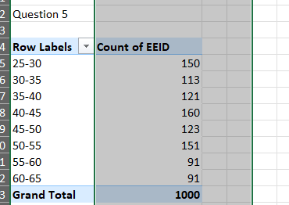
Question 5:
Most common age group is 40-45

Slide 6
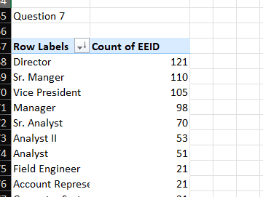
Question 7:
Director is the most common title

Slide 7
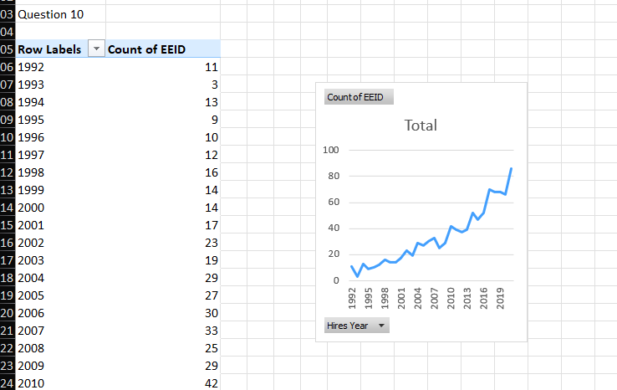
Question 10:
Hiring has seen an increase

Slide 8
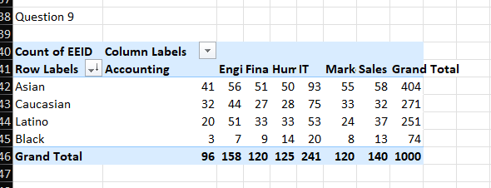
Question 9:
IT is the most diverse

Slide 9
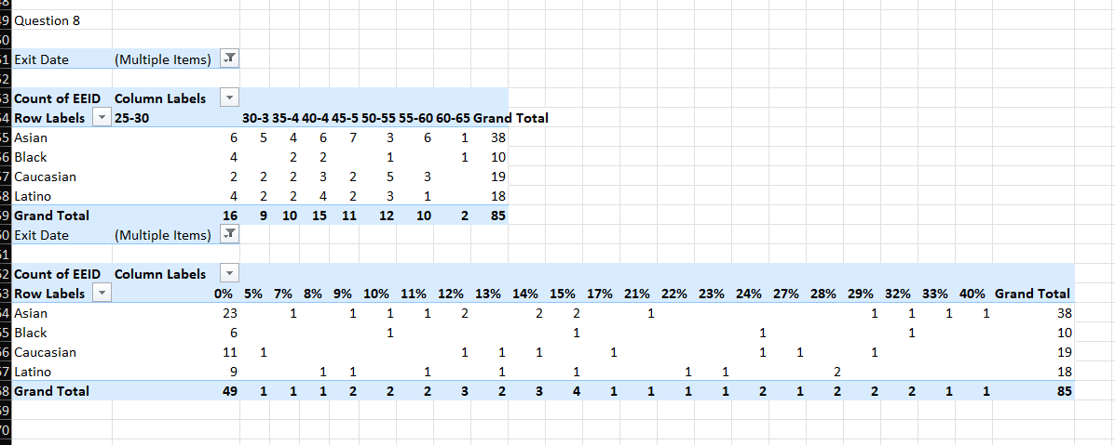
Question 8:
Asian people left and people with 0% bonus are the people who left most

